Slide 1

Python: Multiple Regression
Žydrūnė Kelpšaitė
Data Analyst
2026

Slide 2
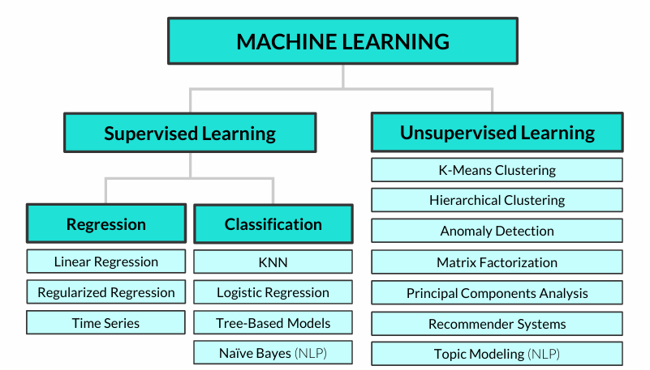
COMMON ALGORITHMS

Slide 3
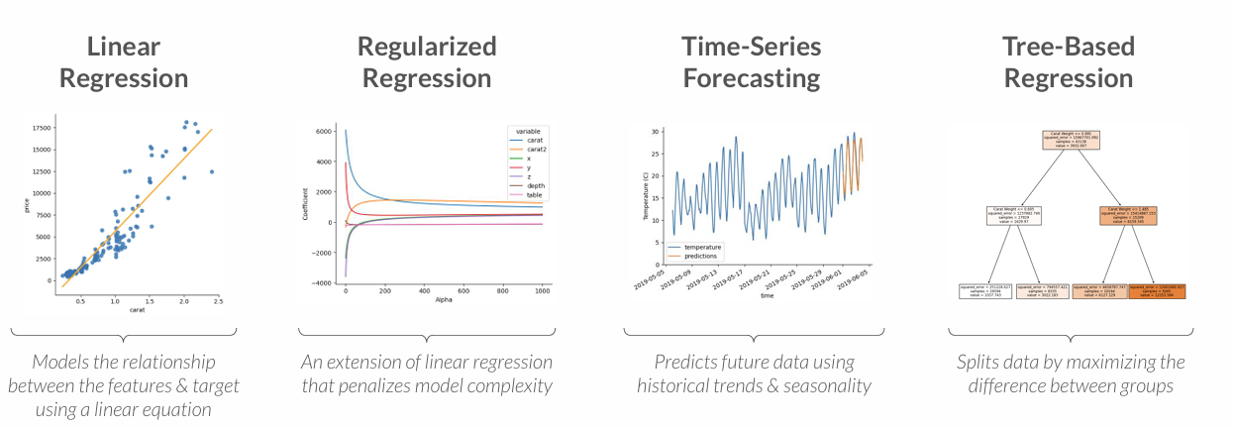
TYPES OF REGRESSION
These are some of the major types of regression modeling techniques
Even though logistic regression (which you may have heard of) has “regression” in its name, it’s actually a classification modeling technique!

Slide 4
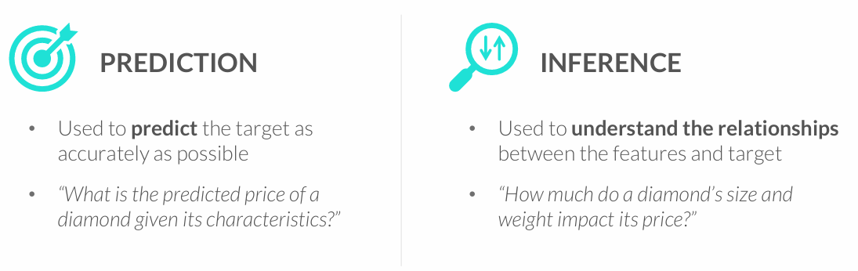
GOALS OF REGRESSION
Regression models are used for two primary goals: prediction and inference
• The goal shapes the modeling approach, including the regression algorithm used, the complexity of the model, and more
You often need to strike a balance between these goals – a model that is very inaccurate won’t be too trustworthy for inference, and understanding the impact that variables have on predictions can help make them more accurate

Slide 5
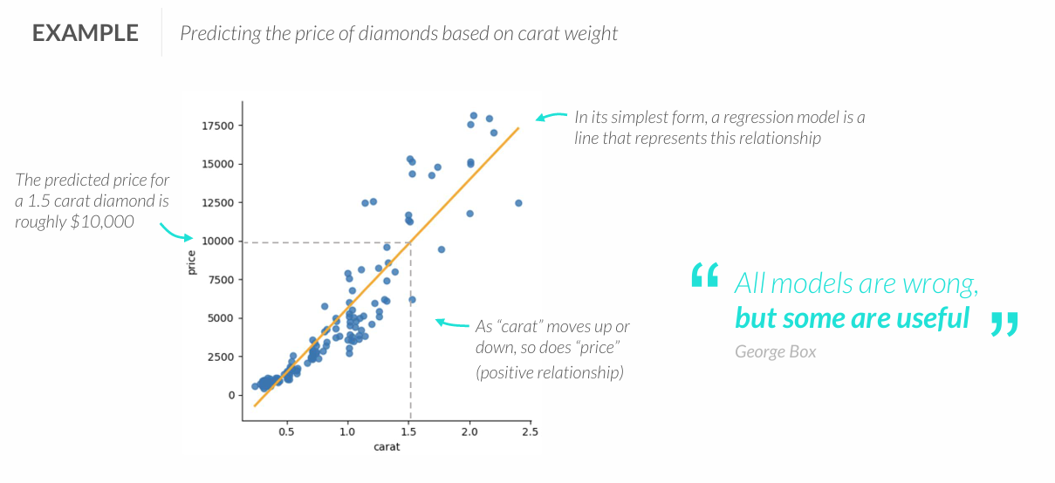
REGRESSION 101
Regression analysis is supervised learning technique used to predict a numeric variable (target) by modeling its relationship with a set of other variables (features)

Slide 6
REGRESSION 101
Regression analysis is supervised learning technique used to predict a numeric variable (target) by modeling its relationship with a set of other variables (features)

Slide 7
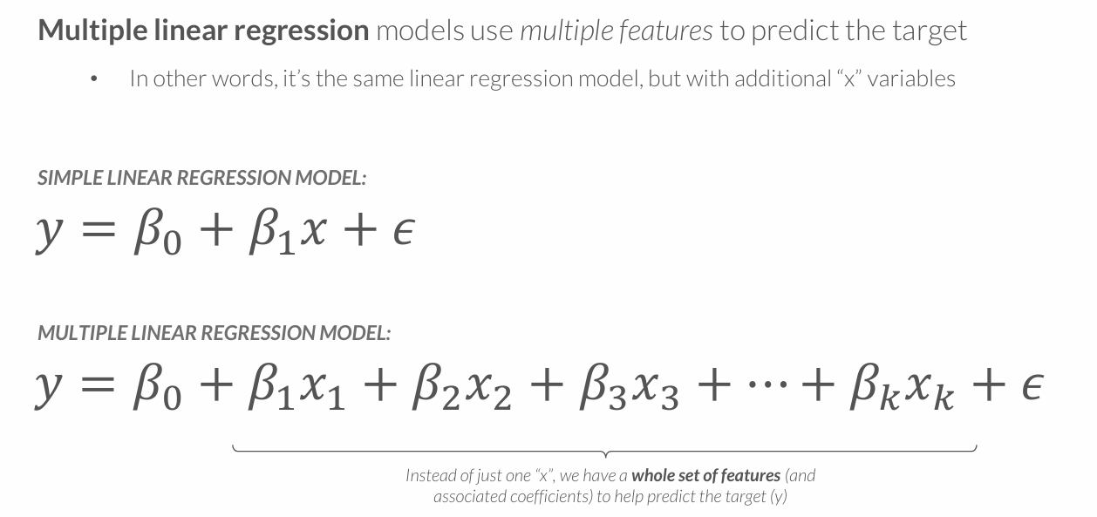
MULTIPLE LINEAR REGRESSION

Slide 8
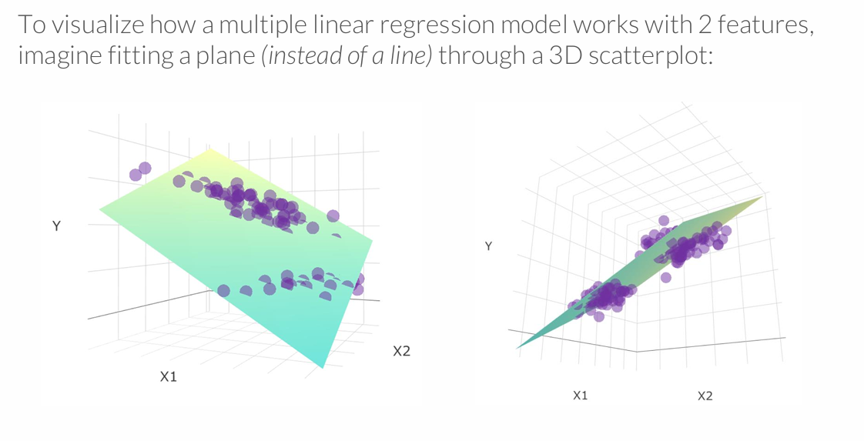
MULTIPLE LINEAR REGRESSION MODEL
Multiple regression can scale well beyond 2 variables, but this is where visual analysis breaks down – and one reason why we need machine learning!

Slide 9
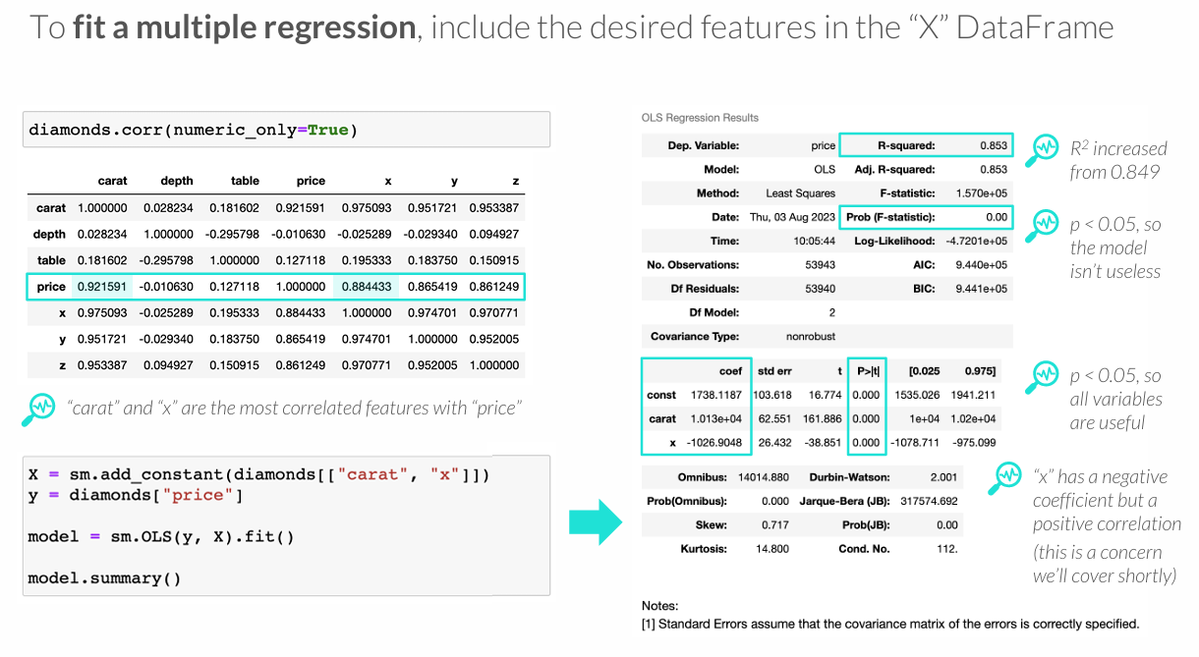
FITTING A MULTIPLE REGRESSION

Slide 10
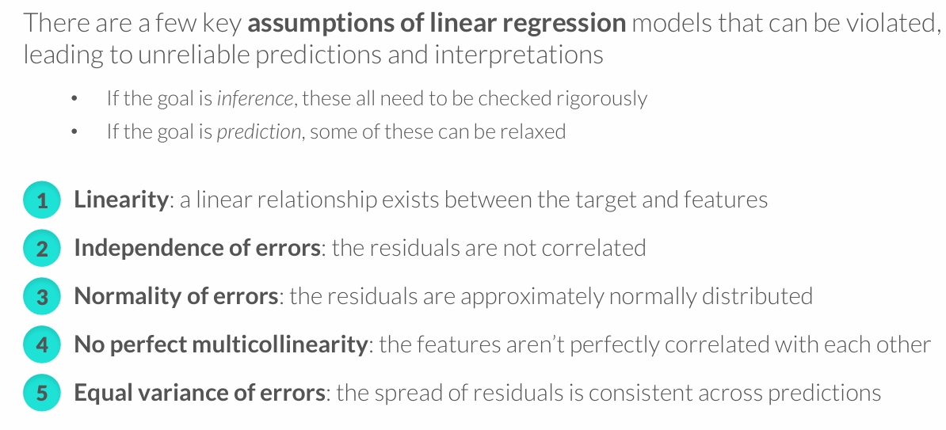
ASSUMPTIONS OF LINEAR REGRESSION

Slide 11
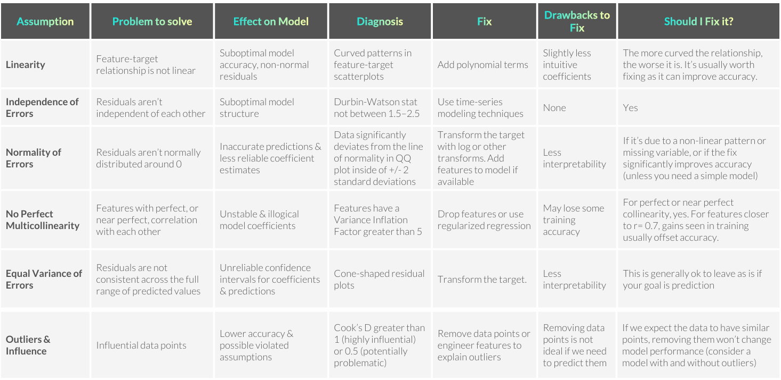

Slide 12
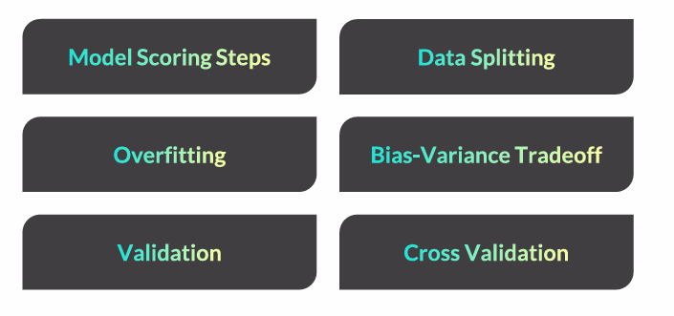
MODEL TESTING & VALIDATION

Slide 13
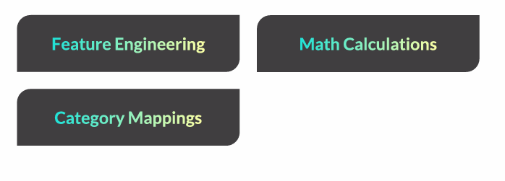
FEATURE ENGINEERING

Slide 14
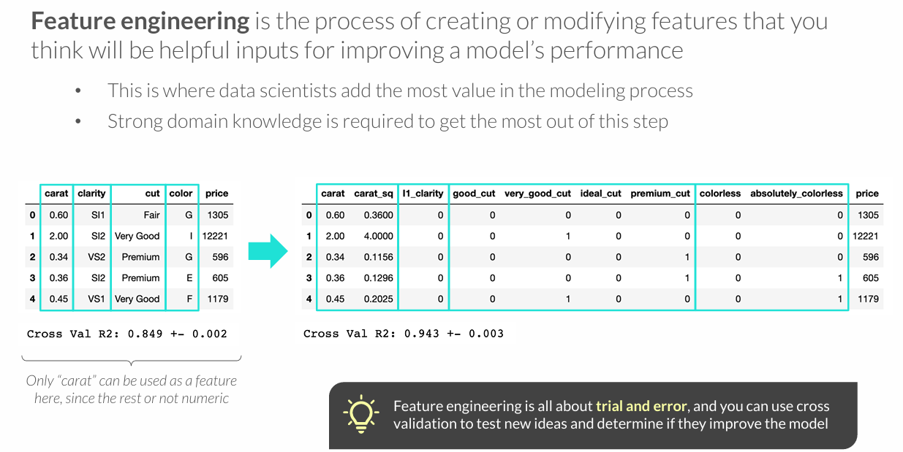
FEATURE ENGINEERING

Slide 15
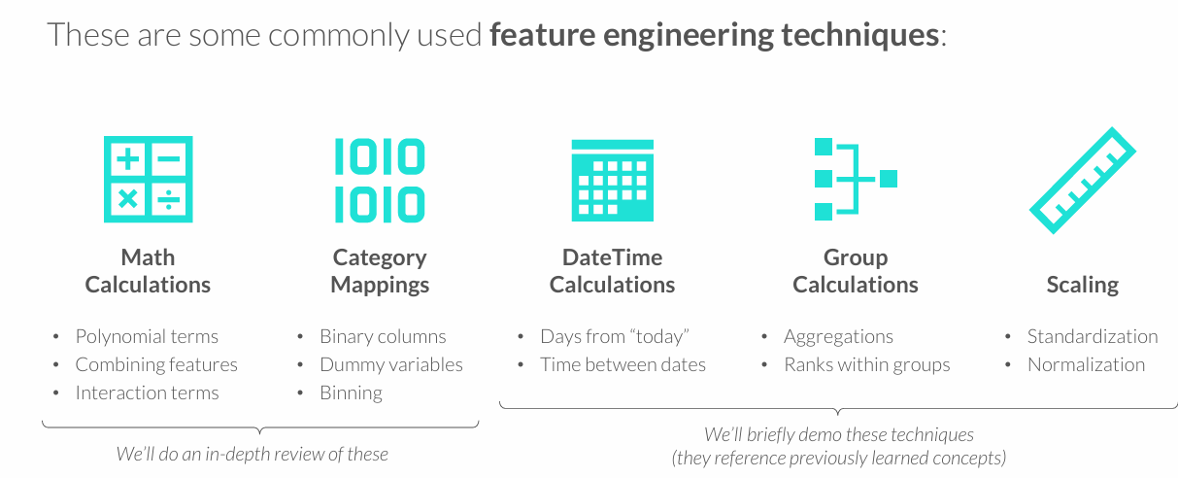
FEATURE ENGINEERING TECHNIQUES

Slide 16
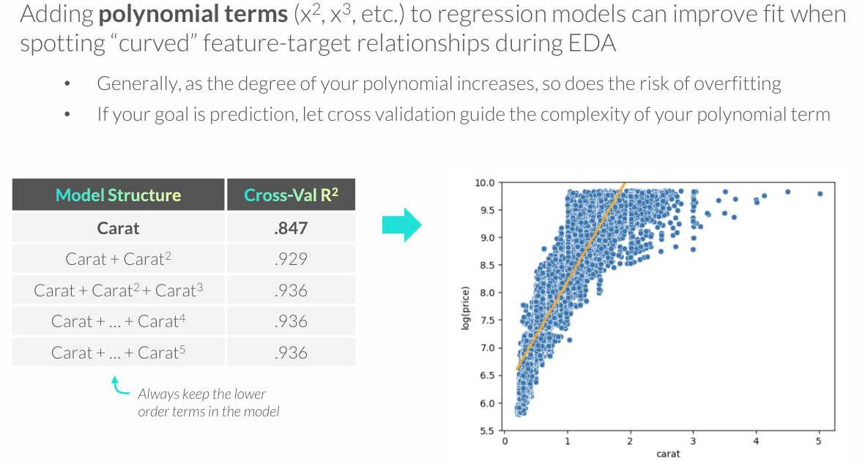
POLYNOMIAL TERMS

Slide 17
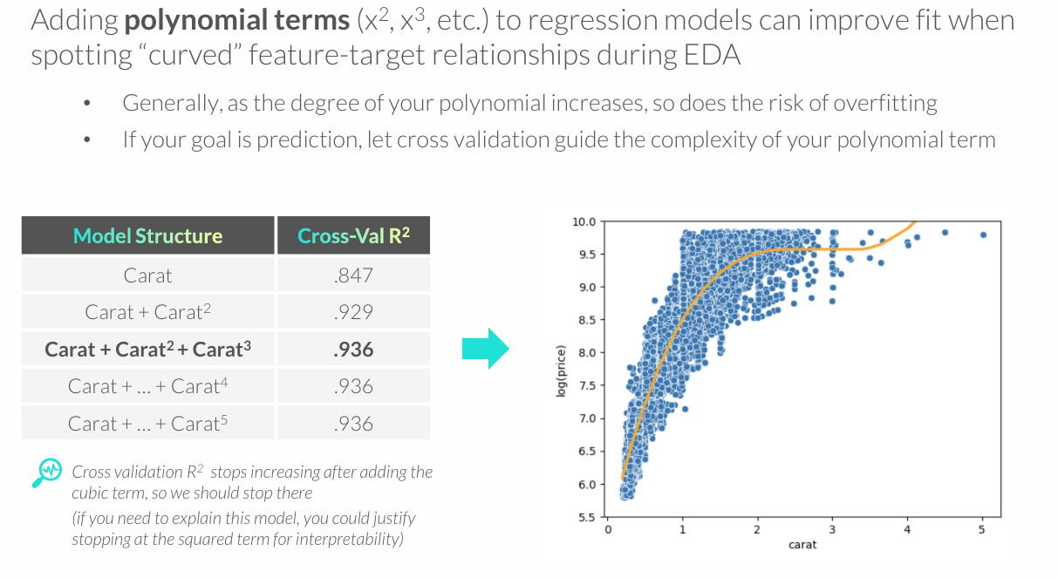
POLYNOMIAL TERMS

Slide 18
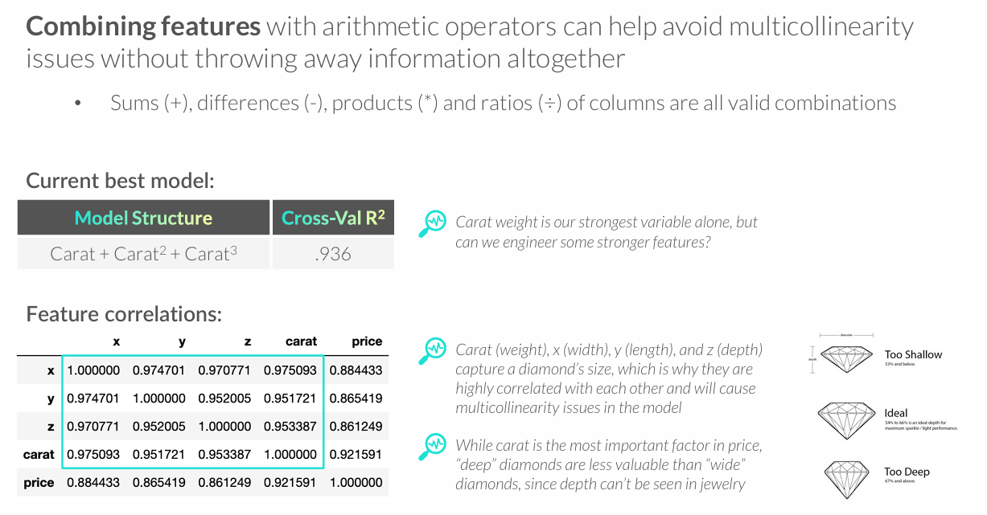
COMBINING FEATURES

Slide 19
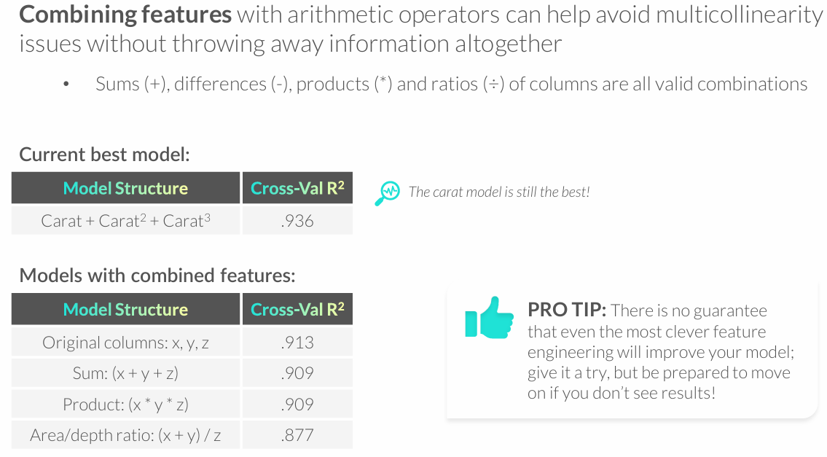
COMBINING FEATURES

Slide 20
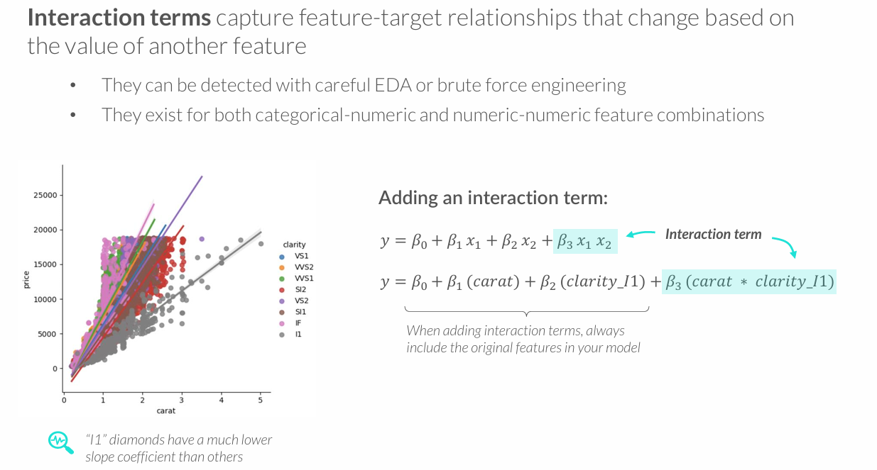
INTERACTION TERMS

Slide 21
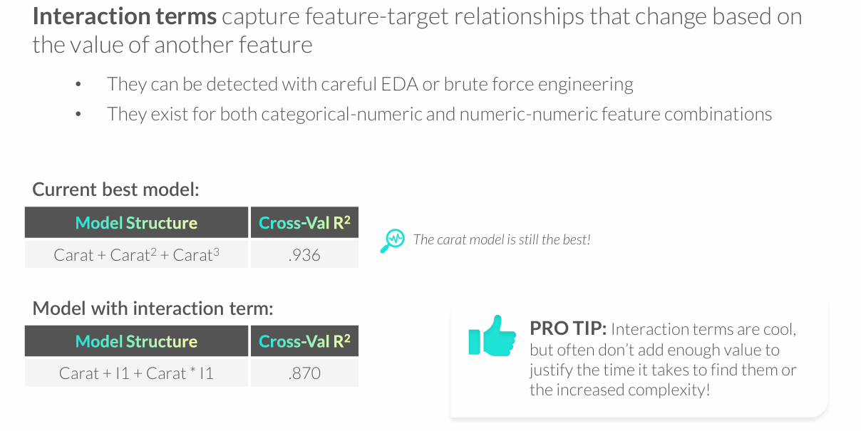
INTERACTION TERMS

Slide 22
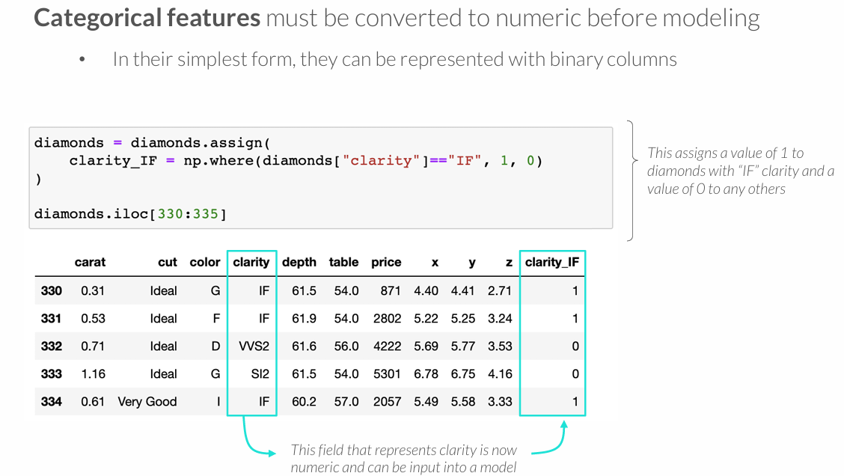
CATEGORICAL FEATURES

Slide 23
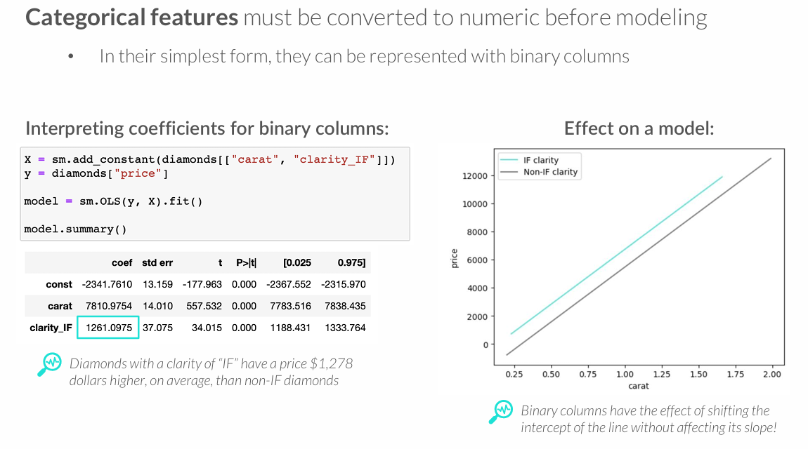
CATEGORICAL FEATURES

Slide 24
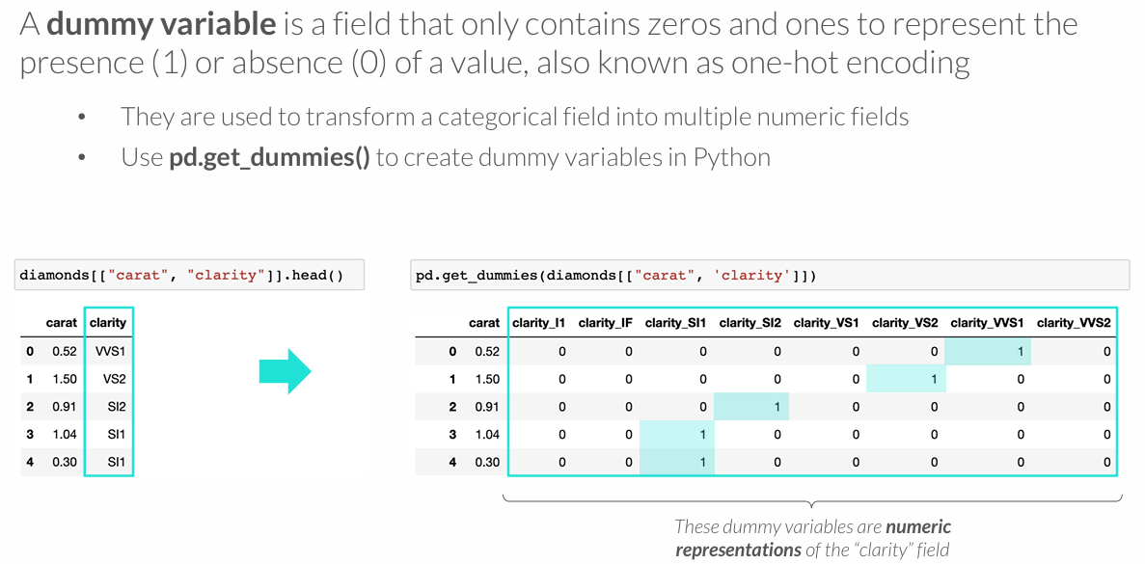
DUMMY VARIABLES

Slide 25
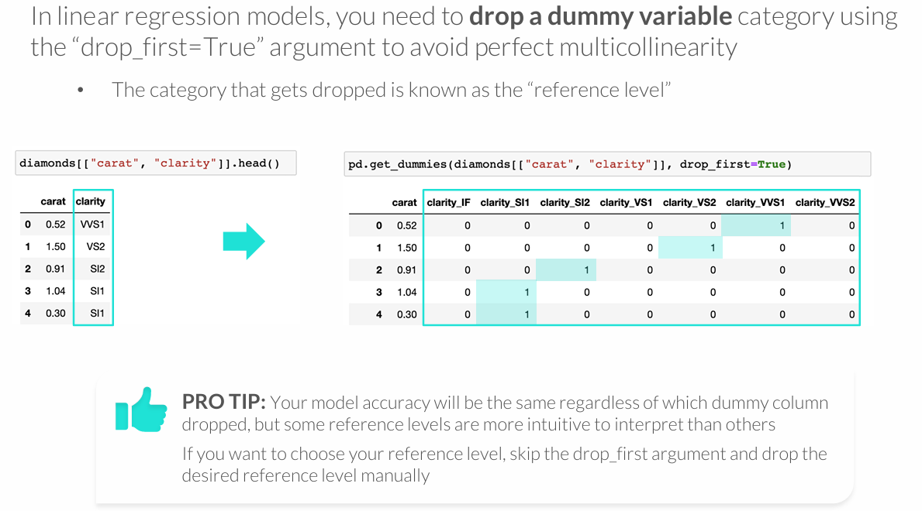
DUMMY VARIABLES

Slide 26
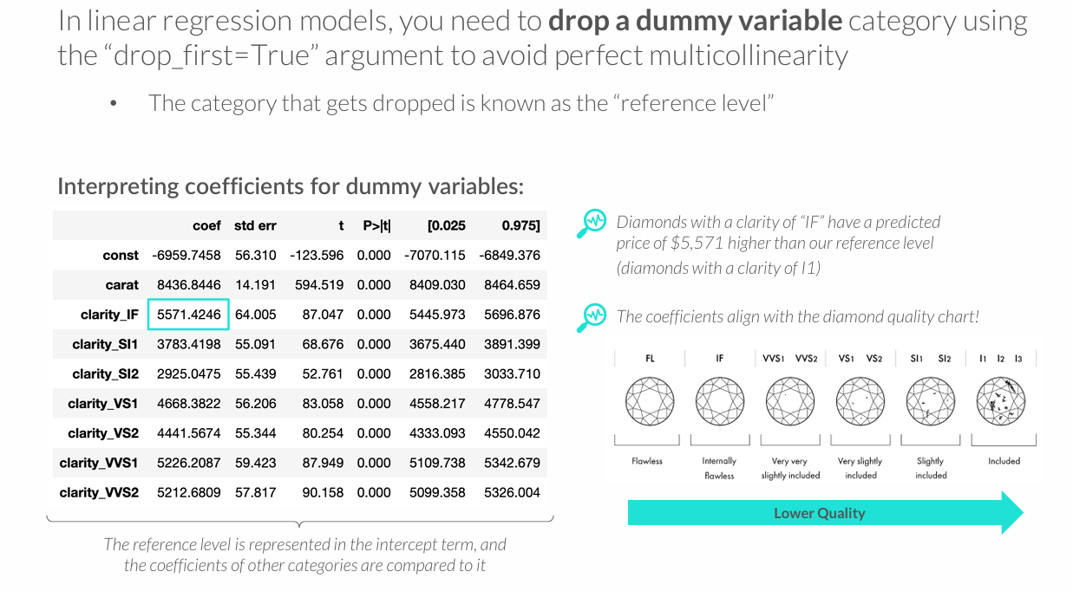
DUMMY VARIABLES

Slide 27
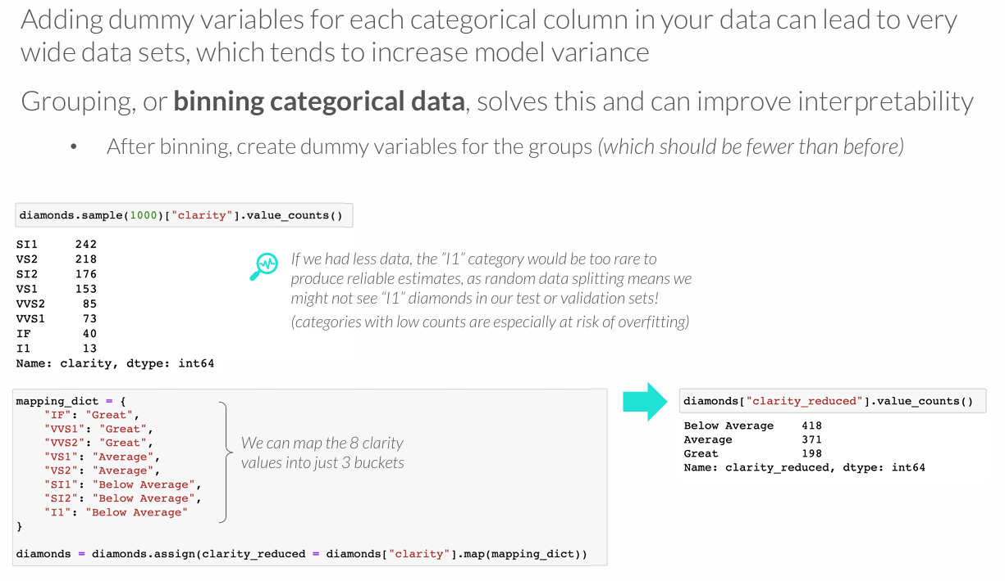
BINNING CATEGORICAL DATA

Slide 28
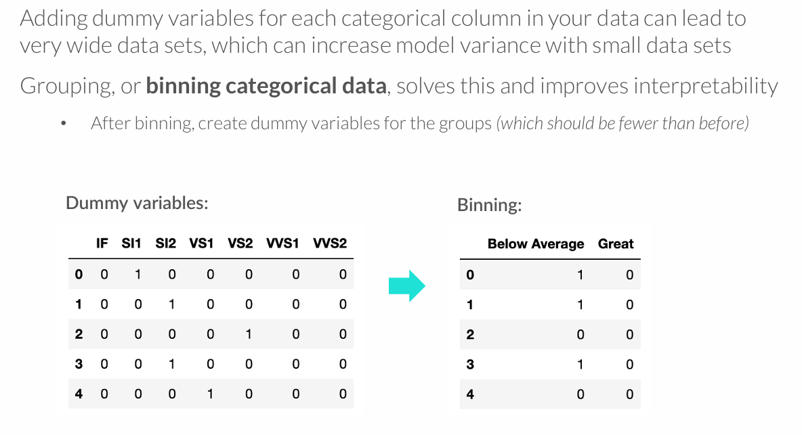
BINNING CATEGORICAL DATA

Slide 29
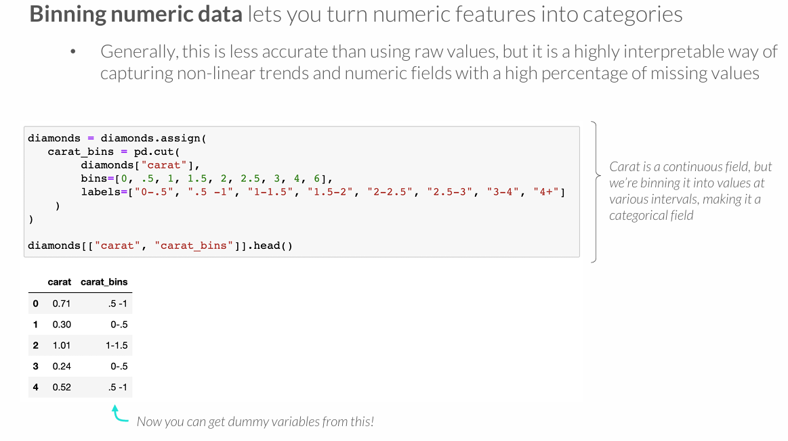
BINNING NUMERIC DATA

Slide 30
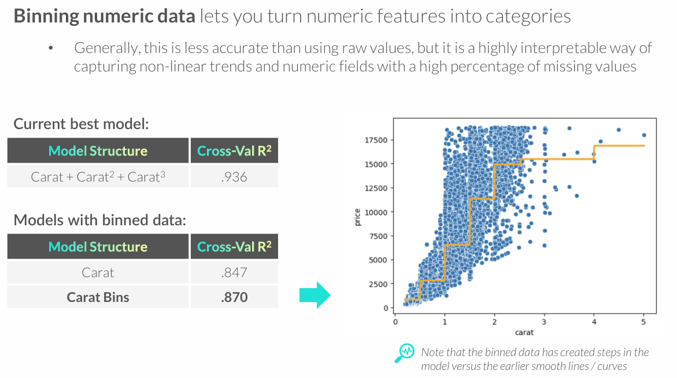
BINNING NUMERIC DATA

Slide 31
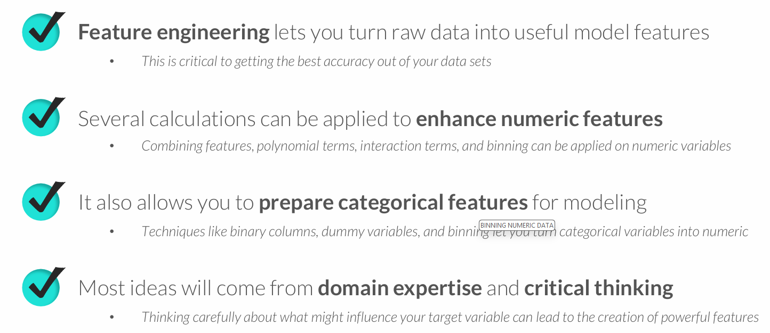
KEY TAKEAWAYS

